Slide 1

QR Code Templates for
Satisfaction Surveys
During and after the stay
½ letter size
(5.1 x 8.2 inches)

Slide 2
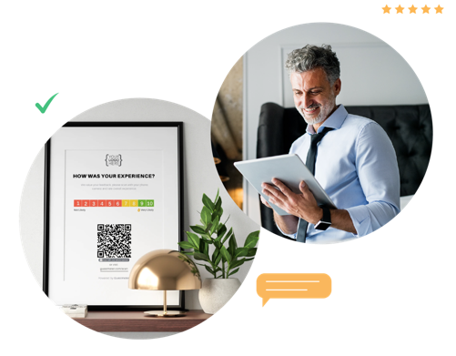
QR code
Templates
QR code surveys placed in the hotel's various locations have an average 70% higher response rate than email surveys.
Below you will find a series of templates for you to insert your QR code.

Slide 3
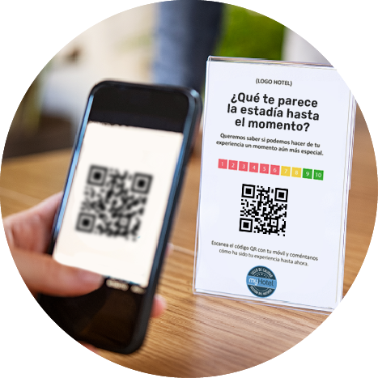
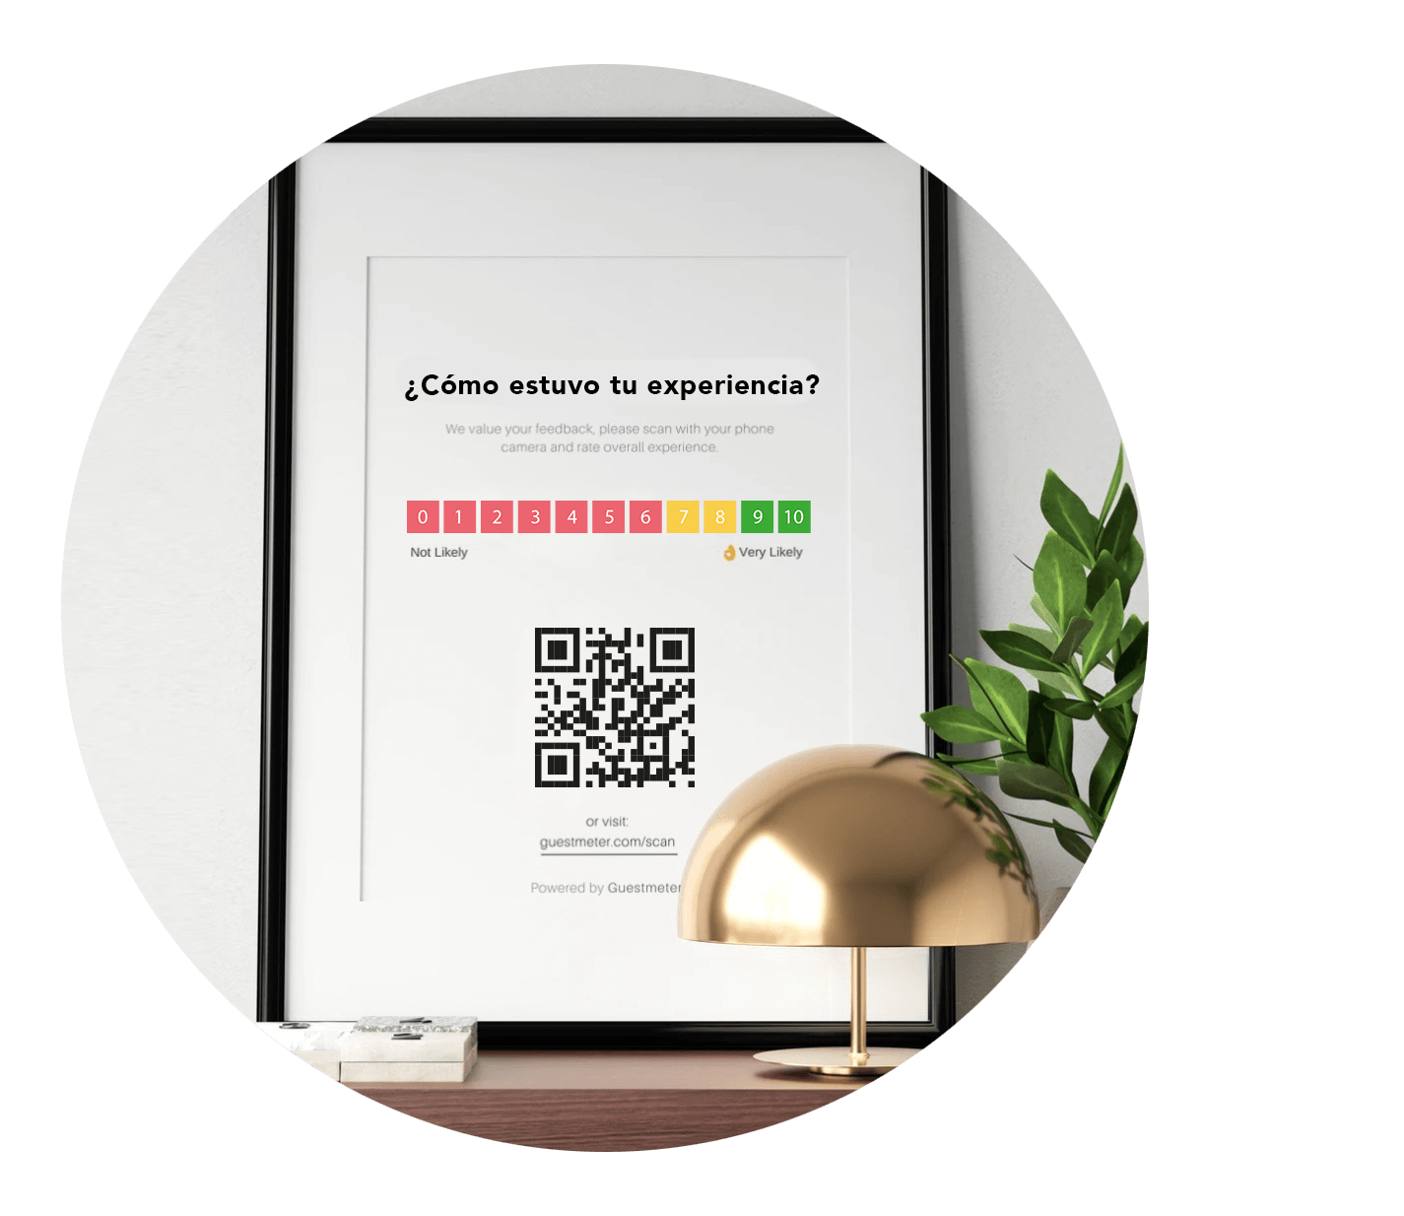
User's manual
MEASURES AND IMPLEMENTATION
5.1 inch
5.1 X 8.2 inches
(width by height)
Half letter size
8.2
inch
The half letter size is ideal for in the rooms or common areas of the hotel, such as the reception, restaurant, etc.
SUPPORT
It can be inserted in large supports for half-letter size sheets such as photo frames or acrylics, among others.
TEMPLATE EDITING
All texts and colors are editable.
The myHotel seal of quality can be kept or removed from the graphic.
Add the QR Code of your hotel in each template.
You can change the file size in settings. Another recommended size is letter size.

Slide 4

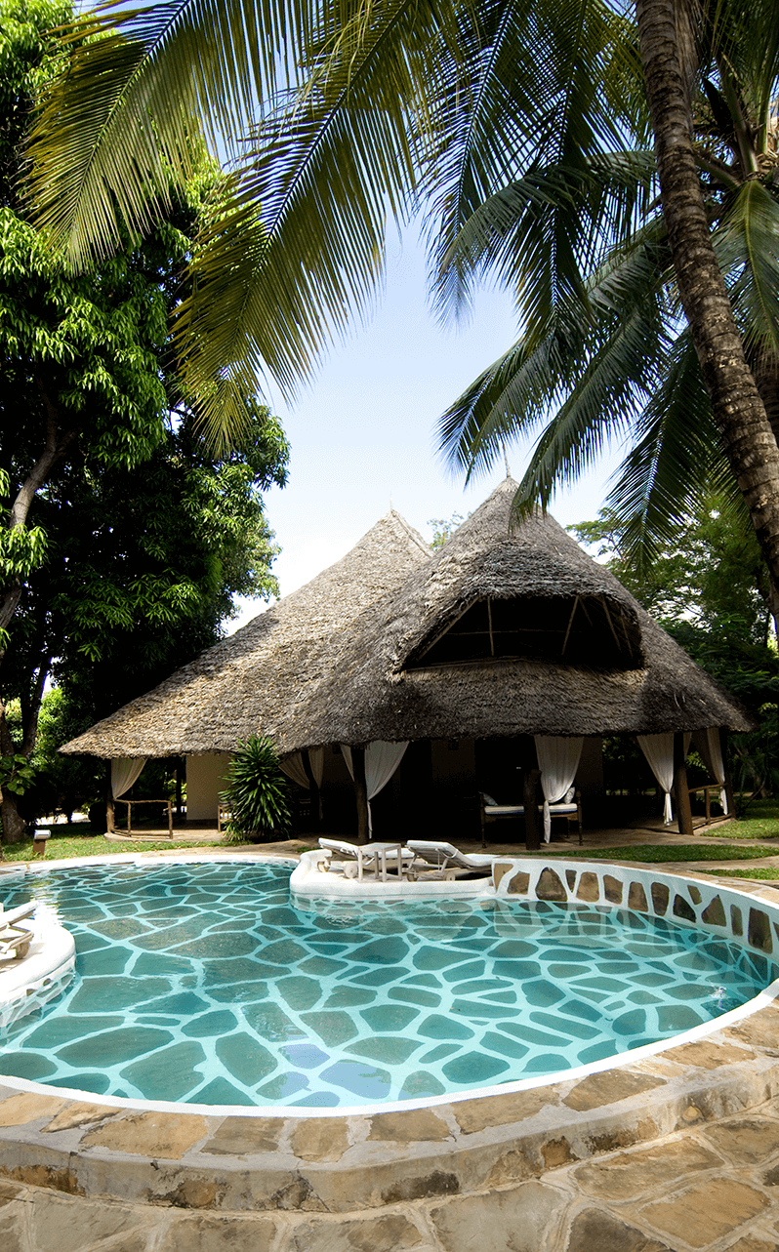

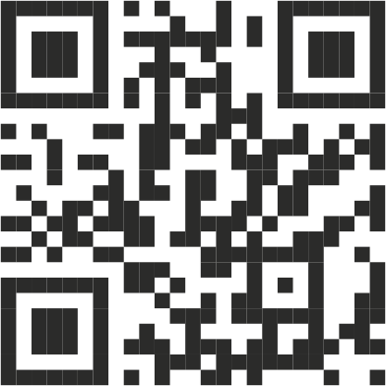

Hotel Logotype
We want to know your opinion
How would you rate your stay with us?
Replace QR code
Thank you for sharing your experience with us!

Slide 5


HOTEL LOGOTYPE
We want to know your opinion
What do you think of the spa service?
Replace QR code
Thank you for sharing your experience with us!

Slide 6
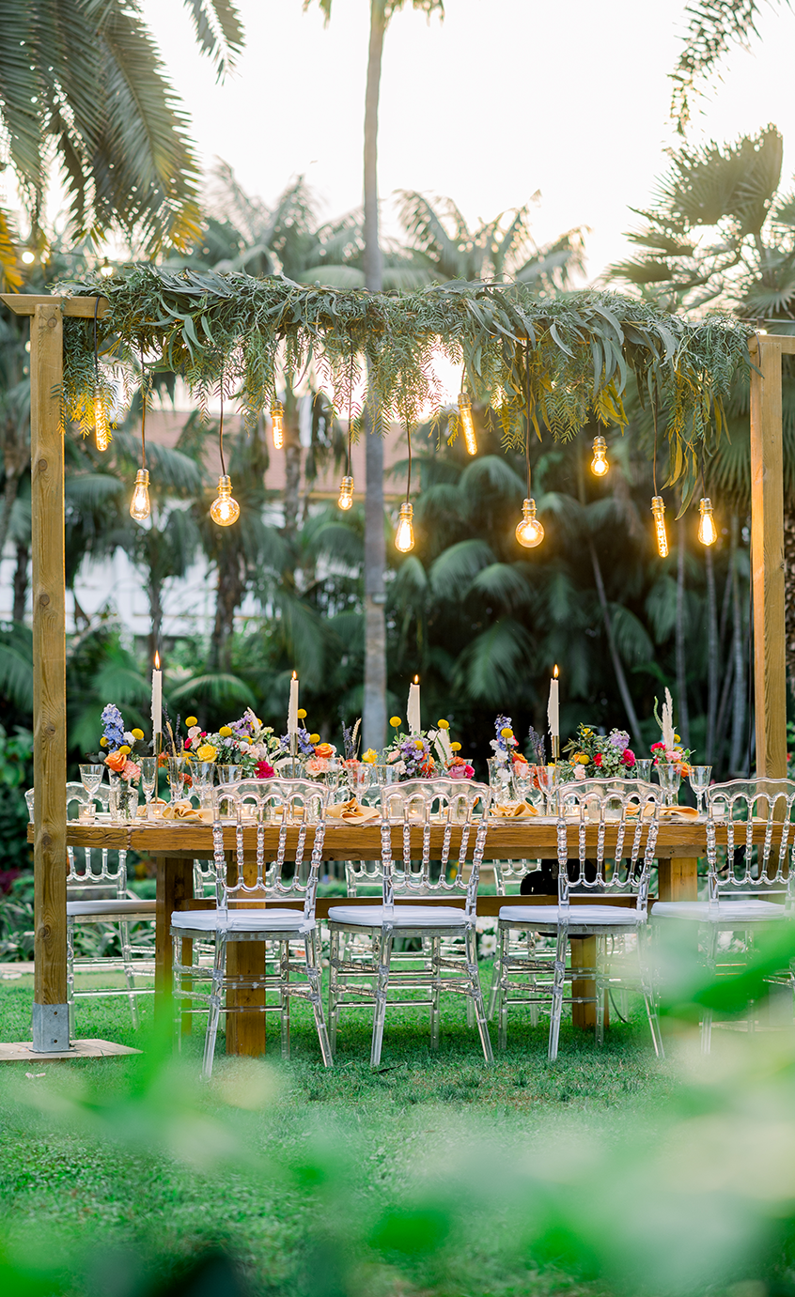
HOTEL LOGOTYPE
What do you think of the event?
Replace QR code
We want to know your opinion
Thank you for sharing your experience with us!

Slide 7
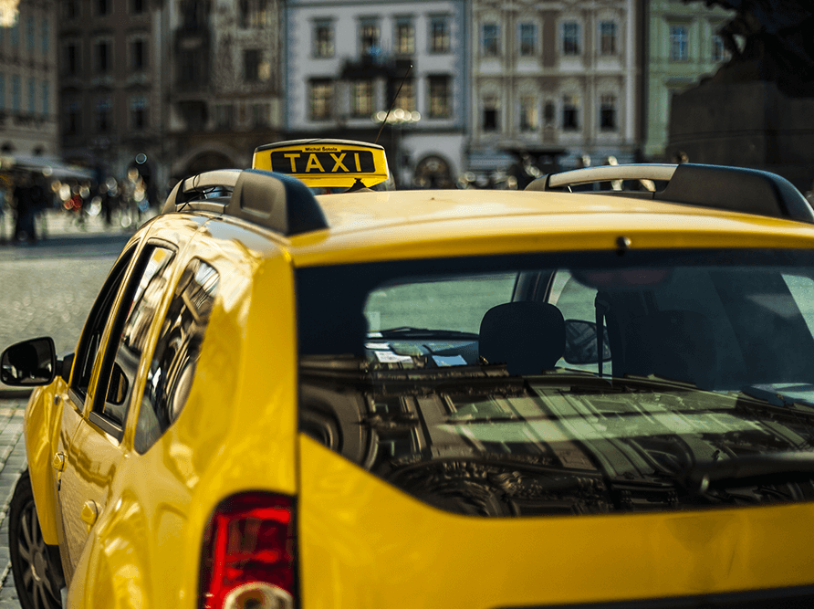

HOTEL LOGOTYPE
What did you think of our cab service?
Replace QR code
Thank you for sharing your experience with us!
Thank you for sharing your experience with us!

Slide 8
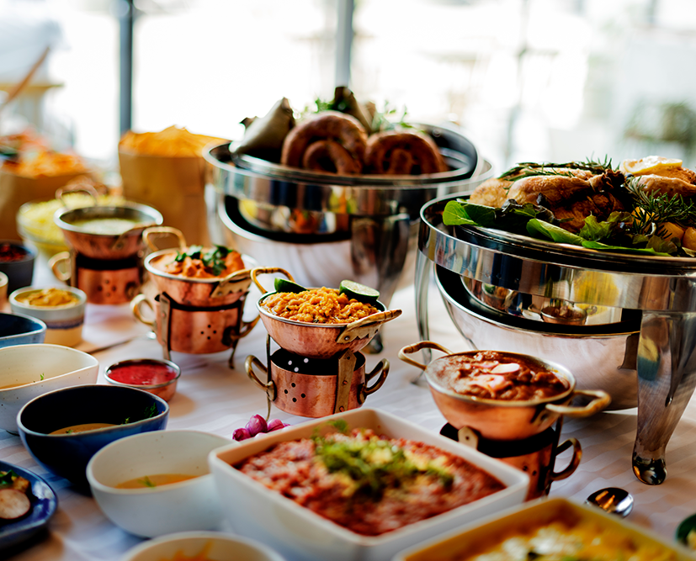
HOTEL LOGOTYPE
What did you think of our buffet?
Replace QR code
Thank you for sharing your experience with us!
Thank you for sharing your experience with us!

Slide 9

HOTEL LOGOTYPE
WHAT DO YOU THINK OF OUR TOUR?
Answer survey
We want to know your opinion
Replace QR code
Thank you for sharing your experience with us!

Slide 10

HOTEL LOGOTYPE
WHAT DO YOU THINK OF YOUR STAY?
Answer survey
We want to know your opinion
Reemplazar QR
Thank you for sharing your experience with us!

